Slide 1
Programming Language II CSE-215
Prof. Dr. Mohammad Abu Yousuf
yousuf@juniv.edu

Slide 2
Multithreaded Programming-4

Slide 3
I Inter-thread Communication
If you are aware of inter-process communication then it will be easy for you to understand inter thread communication.
Inter thread communication is important when you develop an application where two or more threads exchange some information.
There are simply three methods (next slide) and a little trick which makes thread communication possible.

Slide 4
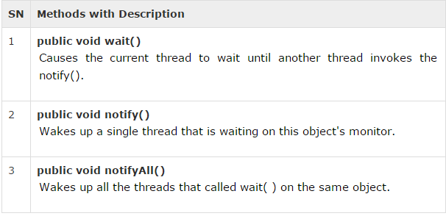
Inter-thread Communication
These methods have been implemented as final methods in Object, so they are available in all the classes. All three methods can be called only from within a synchronized context.

Slide 5
Difference between wait and sleep?
wait() | sleep()
wait() method releases the lock | sleep() method doesn't release the lock.
is the method of Object class | is the method of Thread class
is the non-static method | is the static method
is the non-static method | is the static method
should be notified by notify() or notifyAll() methods | after the specified amount of time, sleep is completed.

Slide 6
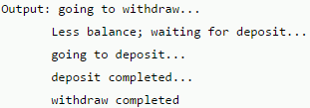
class Customer{
int amount=10000;
synchronized void withdraw(int amount){
System.out.println("going to withdraw...");
if(this.amount<amount){
System.out.println("Less balance; waiting for deposit...");
try{wait();}catch(Exception e){}
}
this.amount-=amount;
System.out.println("withdraw completed..."); }
synchronized void deposit(int amount){
System.out.println("going to deposit...");
this.amount+=amount;
System.out.println("deposit completed... ");
notify();
} }
class Test{
public static void main(String args[]){
final Customer c=new Customer();
new Thread(){
public void run(){c.withdraw(15000);}
}.start();
new Thread(){
public void run(){c.deposit(10000);}
}.start(); }}

Slide 7
Example: Inter-thread Communication
This example (next 3 slides) shows how two thread can communicate using wait() and notify() method.

Slide 8
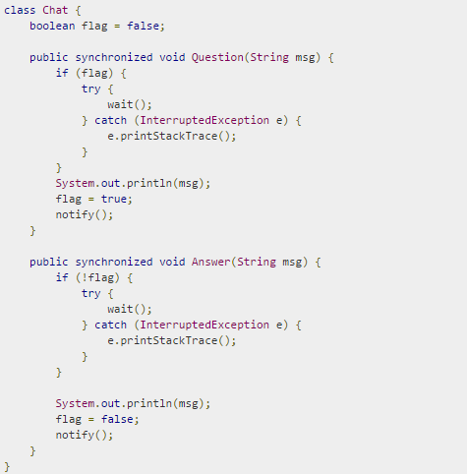
Example: Inter-thread Communication

Slide 9
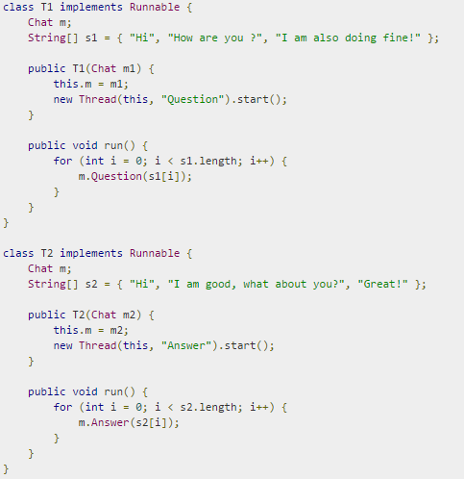
Example: Inter-thread Communication

Slide 10
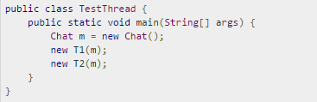
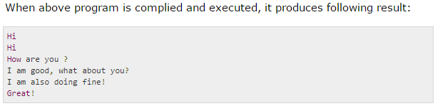
Example: Inter-thread Communication

Slide 11
Thank you

